Slide 1

2025 Postcode Loterij Attribution
Stewart Patterson

Slide 2
Part 1:
Technical Perspective

Slide 3
Data Preparation

Slide 4
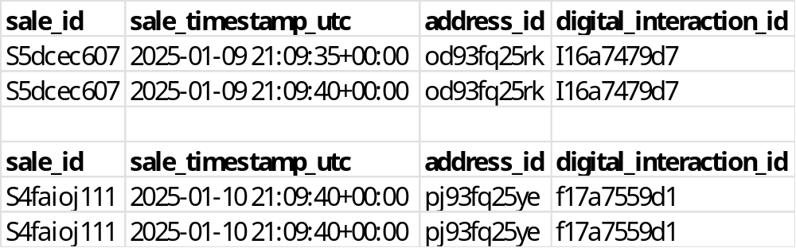
Data Preparation - Sales
Checks
Actions Taken
Duplicate Rows
Remove Duplicates
Duplicate sale_id
Timestamp ~5 seconds apart
Keep only the first record
Messy ID’s
Capitalize and remove spaces
Check for missing data
Check for duplicates on primary key sale_id
Check if any anomalous lengths of sale_id
Check if all data in 2025
Visual inspection

Slide 5
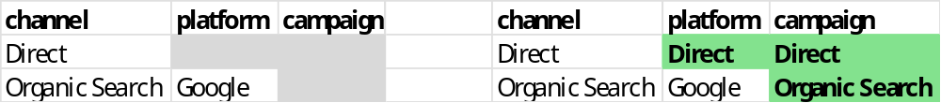
Data Preparation – Digital Interactions
Checks
Actions Taken
Look at counts of categorical data
Check for missing data
Check for duplicates on primary key sale_id
Check if any anomalous lengths of id columns
Check if all data in 2025
Check that campaign matches platform
  i.e. Google ≠ Instagram
Visual inspection
Empty Categories
Fill Empty Categories
Messy ID’s
Capitalize and remove spaces

Slide 6
Data Preparation – TV Spots
Checks
Actions Taken
Check distribution of impressions
Check for missing data
Check for duplicates on primary key spot_id /air_time
Check if all data in 2025
Visual inspection
None needed 😎

Slide 7
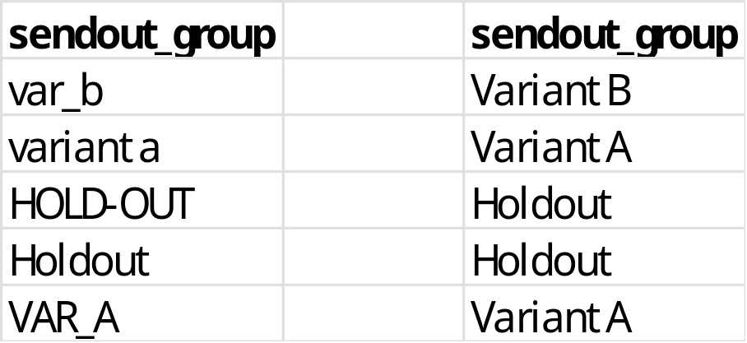
Data Preparation – DM Sendouts
Checks
Actions Taken
Check distribution of sendout counts per sendout
Check for missing data
Check for duplicates on primary key address_id
Check if all data in 2025
Visual inspection
Un-standardized Sendout Group Names
Standardize Sendout Group Names
Messy ID’s
Capitalize and remove spaces

Slide 8
Baselines

Slide 9
Direct Link Attribution
Sales
address_id
cookie_id
DM Sendouts
Digital Interactions

Slide 10
Direct Link Attribution
Assumptions
Excluded if only interaction is one of:
Paid Search
Organic Search
Direct
Digital
Interactions
1995
Digital &
DM Sendout
3558
DM Sendout
2999
Digital Interactions older than 7 days before sale are excluded
Digital
Interactions
5553
DM Sendout
6557

Slide 11
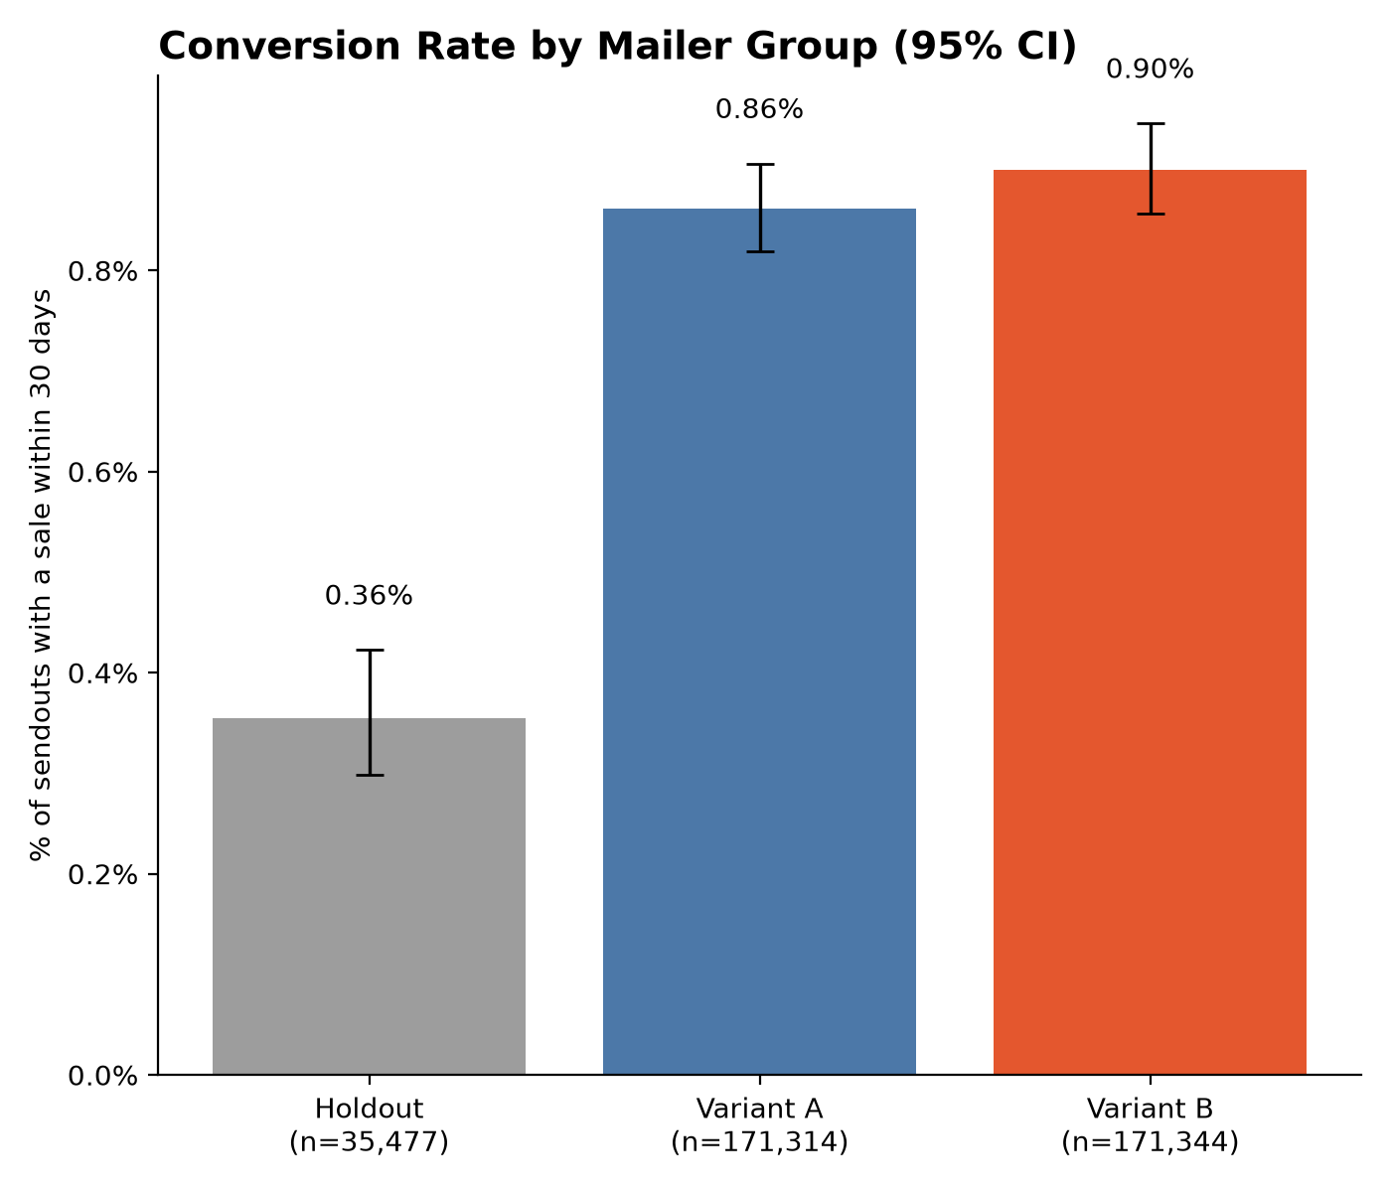





Incremental Lift for DM Sendout
Incremental Lift
$$x sales ∗\frac{({CR}_{test}−{CR}_{holdout})}{{CR}_{holdout}}$$
$$= x sales ∗\frac{(0.88−0.36)}{0.88}$$
$$= x sales ∗0.59$$
$$=6557 ∗0.59$$
$$=3875 sales caused$$
Notes:
Used day of TV Spot and next calender day

Slide 12
TV Spot Attribution
?
Sales
TV Spot
address_id
cookie_id
DM Sendouts
Digital Interactions

Slide 13
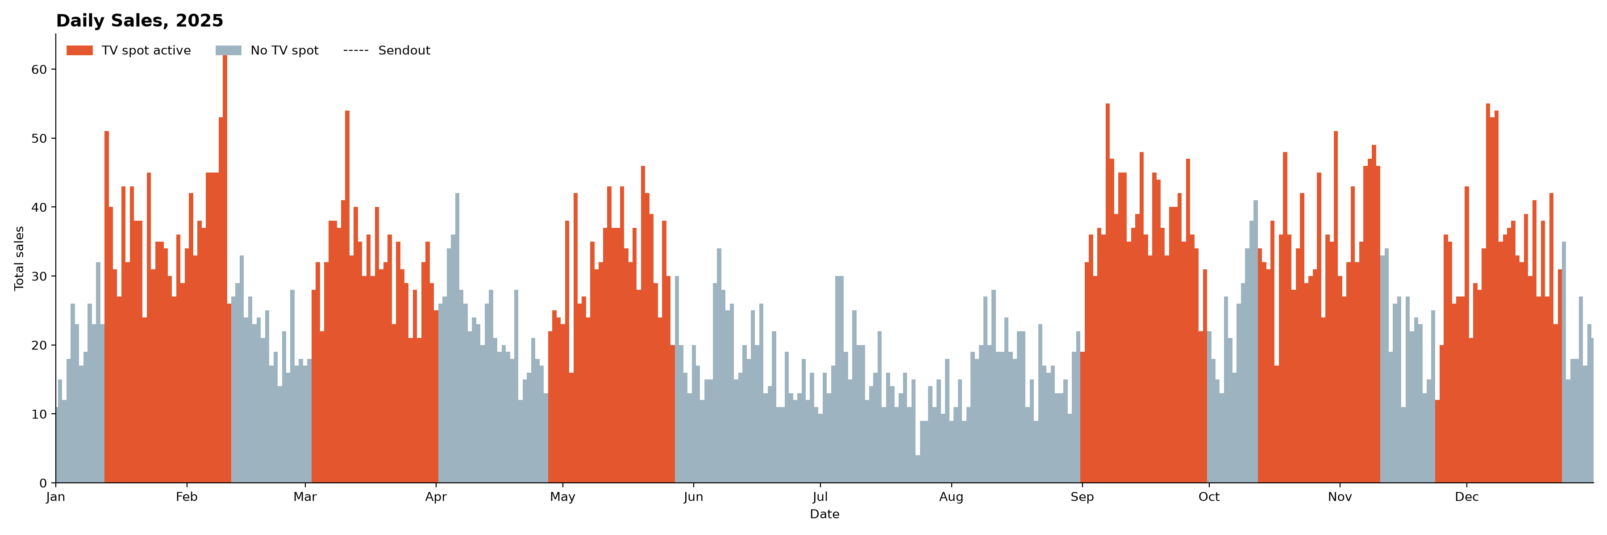
Daily Sales Colored by TV Spot
Insight 1: TV Spot has a positive effect on sales
Insight 2: Effect of TV Spot seems to last for only 1 day
Notes:
Used day of TV Spot and next calender day

Slide 14
Daily Sales Colored by TV Spot
Hypothesis:
Model TV Spot Attribution as:
Flat Increase of ~15 sales per day during TV Spot
Question:
Do TV Spots effect each attribution channel equally
Notes:
Used day of TV Spot and next calender day

Slide 15
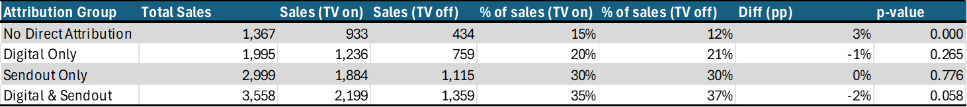
Effect of TV Spots on Attribution Group Proportion
Insight 1: Yes, TV Spot increases sales from the ‘No Direct Attribution’ group relatively more
Insight 2: Differences are small, so they can probably be ignored for a Baseline estimate

Slide 16
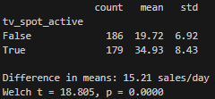
Welch’s t-test
Significant difference in daily sales depending on TV spot
Difference is ~15 sales per day

Slide 17
Daily Sales Colored by TV Spot
TV Spot Baseline Attribution:
Flat Increase of ~15 sales per day during TV Spot
15.21 sales per day * 179 days = 2723 sales
Notes:
Used day of TV Spot and next calender day

Slide 18
Baseline Estimates
Channel | Sales
Digital Interaction | 5553
DM Sendout | 3875
TV Spot | 2723
3558 Shared

Slide 19
Baseline Estimates
Overestimating
Double & Triple attribution
  DM Sendout & Digital Interaction
  TV Spot & DM Sendout & Digital Interaction
Not removing old Sendouts
Channel | Sales
Digital Interaction | 5553
DM Sendout | 3875
TV Spot | 2723
Underestimating
Removing digital Interactions older than 7 days
Not assigning the ‘No Direct Interaction Sales’
Interactions – could underestimate or overestimate
Attributed Sales | 10843
Actual Sales | 9919
1916 (-15% to TV) sales not attributed directly

Slide 20
Exploration
A/B Variants

Slide 21
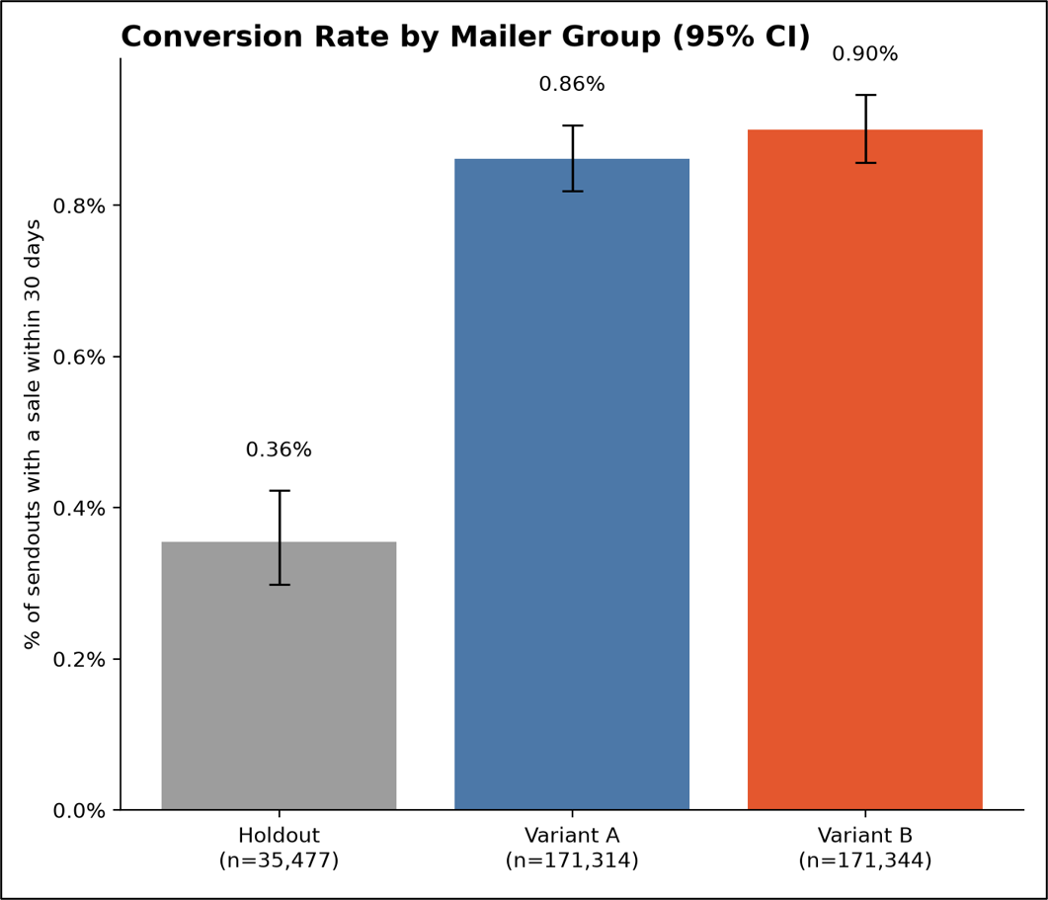
Difference in A & B Variants
Notes:
Used day of TV Spot and next calender day

Slide 22
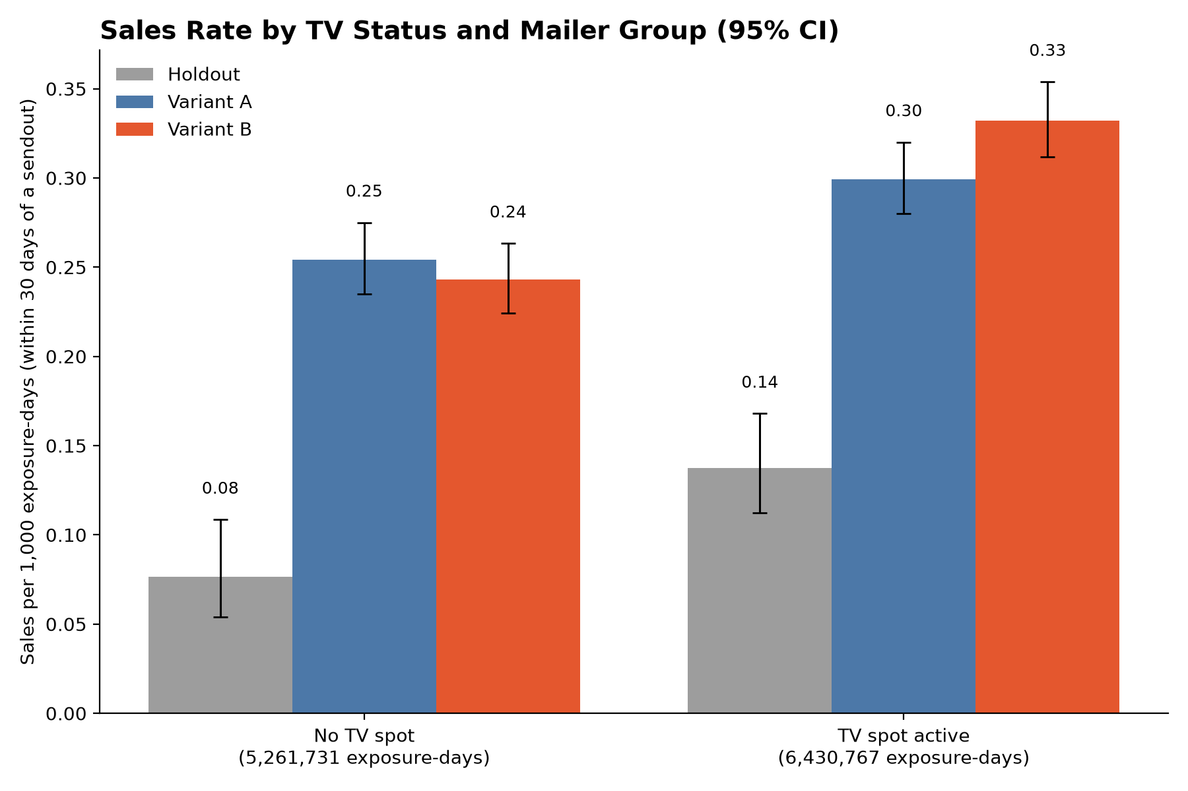
Difference in A & B Variants
Notes:
Used day of TV Spot and next calender day

Slide 23
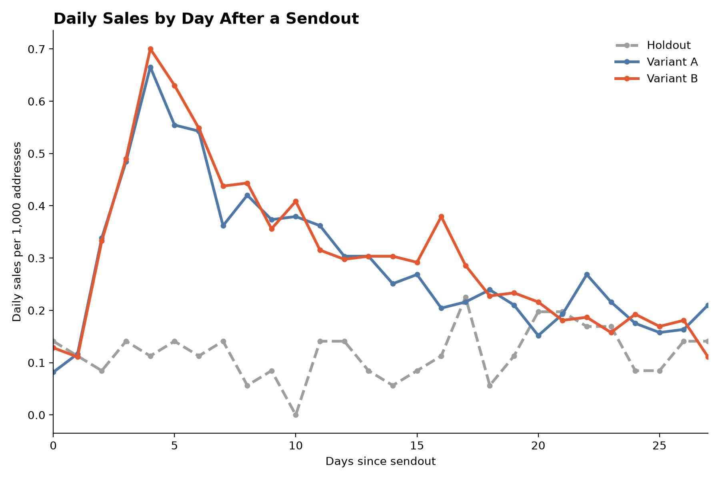
Difference in A & B Variants
DM Sendout Date | Days Between
1/7/2025 | NA
2/4/2025 | 28
3/4/2025 | 28
4/1/2025 | 28
5/6/2025 | 35
6/3/2025 | 28
7/1/2025 | 28
8/5/2025 | 35
9/2/2025 | 28
10/7/2025 | 35
11/4/2025 | 28
12/2/2025 | 28
Notes:
Used day of TV Spot and next calender day

Slide 24

Difference in A & B Variants
Conclusions:
Slightly different response rate, not large
Response rate over time almost the same

Slide 25
Exploration
Seasonality

Slide 26

2025 Sales by Day
- Colored by TV Spot
- Vertical lines showing DM Sendouts
Notes:
Used day of TV Spot and next calender day

Slide 27
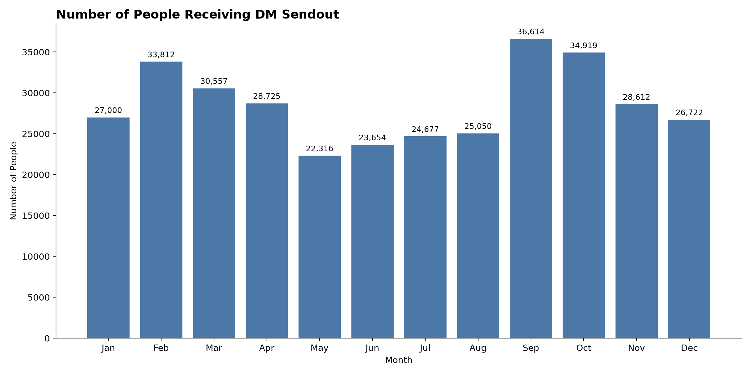
2025 Sales by Day
Notes:
Used day of TV Spot and next calender day

Slide 28
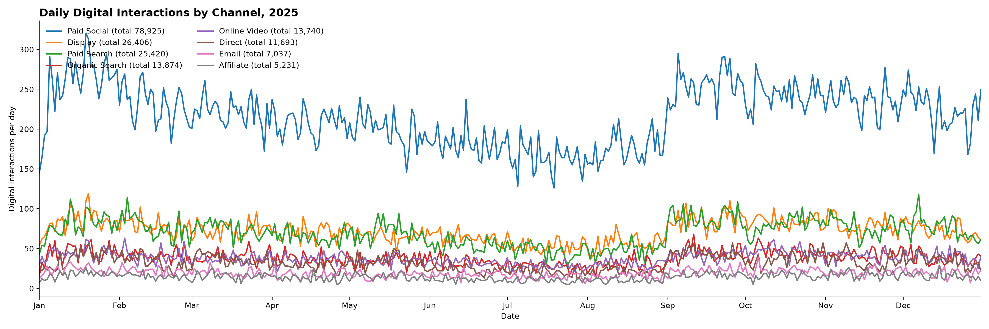
Digital Interactions Channels
Notes:
Used day of TV Spot and next calender day

Slide 29
Insights from Data Exploration
Conclusions:
Big seasons for sales and advertising in September & October
Low seasons for sales and advertising in May - August

Slide 30
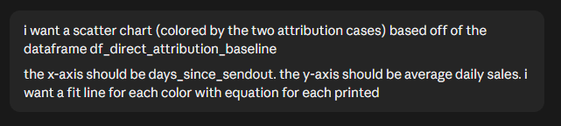
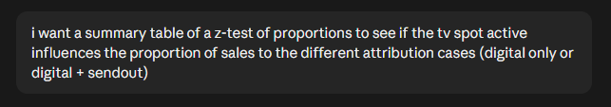
AI Usage
Explain the data
  Verbally
  Image of dataframe
Ask for code charts
Ask for code statistical tests
Notes:
Please include a short explanation of your process: how did you prompt, what did your iteration process look like, and how did you validate the outcomes?

Slide 31
Exploration
DM Sendout Response Time

Slide 32
2025 Sales by Day
- Colored by TV Spot
- Vertical lines showing DM Sendouts
Notes:
Used day of TV Spot and next calender day

Slide 33
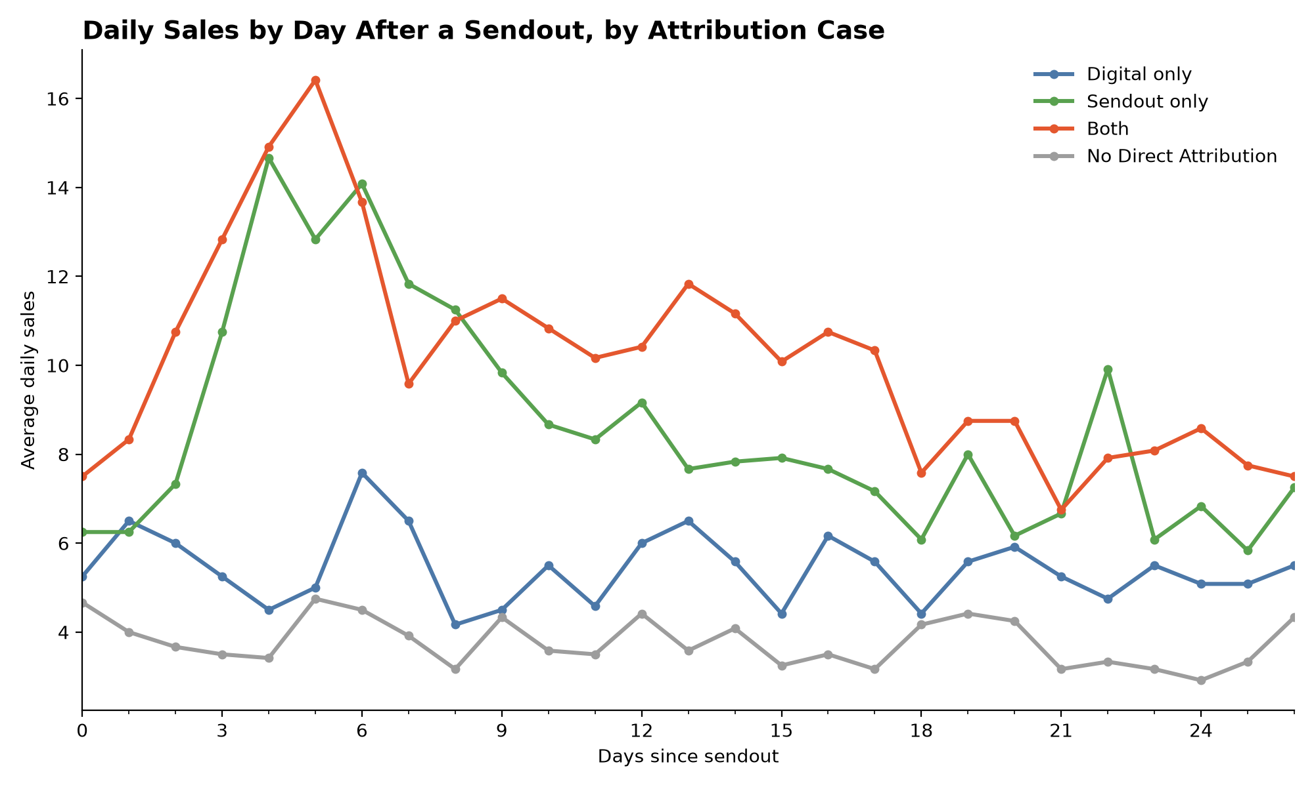
Daily Sales after Sendout by Attribution Case

Slide 34
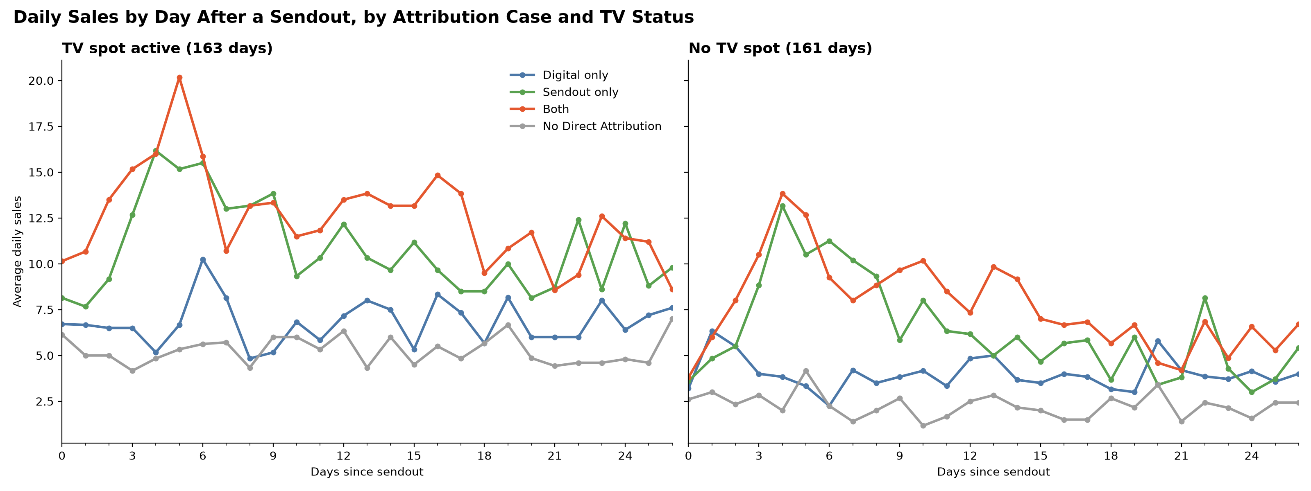
Daily Sales after Sendout by Attribution Case
- Split by TV Spot active or not

Slide 35

Insights from Data Exploration
Conclusions:
The uplift pattern after a direct mail sendout of the ‘Sendout Only’ attribution case is mirrored in the ‘Both’ attribution case
Key Insight:
Early after a direct mail sendout, the ‘Both’ attribution shows the same uptick as ‘Sendout Only’. Thus, the attribution should be shifted a bit toward ‘Sendout Only’

Slide 36
Part 2:
Stakeholder Perspective

Slide 37
2025 Sales Baselines
2025 Actual Sales | 9919
Attributed Sales | 10843
Channel | Sales
Digital Interaction | 5553
DM Sendout | 3875
TV Spot | 2723
3558 Shared

Slide 38

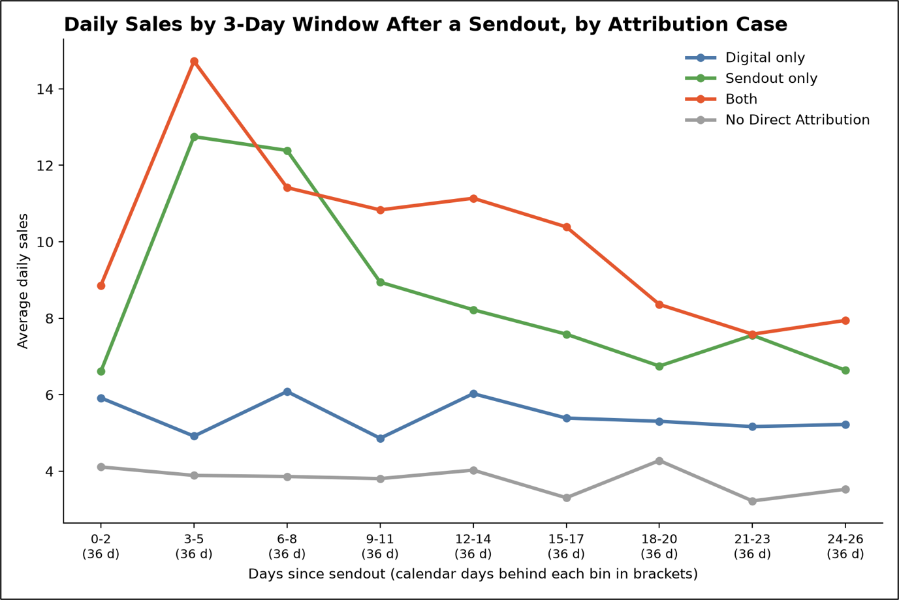

Deep Dive Model
Key Insight:
Early after a direct mail sendout, the ‘Both’ attribution shows the same uptick as ‘Sendout Only’. Thus, the attribution should be shifted a bit toward ‘Sendout Only’
Application:
Reduce the overestimation of Digital Interaction, (particularly when also attributed to Sendout) by attributing some of these sales to ‘Sendout Only’

Slide 39
Model Design
Find a baseline for ‘Both’ sales where effect of sendout is minimum
Use that baseline as a threshold for sales attribution
  Any sales above that threshold counted as ‘Sendout Only’
  Any sales below that continue to be counted as ‘Both’
Calculate baseline independently for different seasons to address seasonal effects confounded by advertising swells
  Use 3 seasons: September & October, May-August, Other

Slide 40
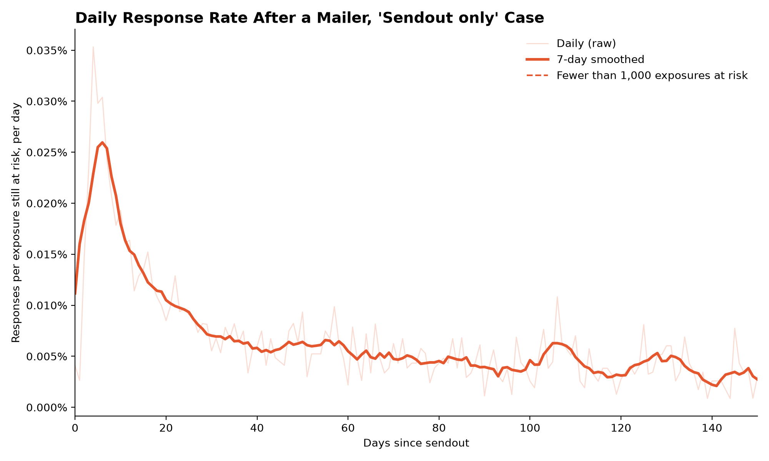
Model Design
Day 27

Slide 41
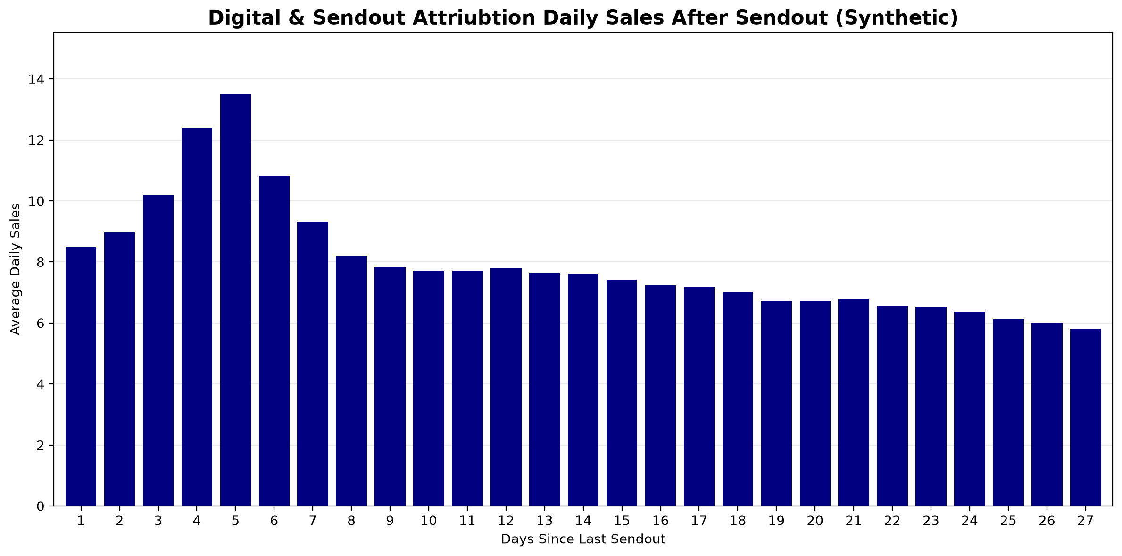
Before Model
Take 27th day after DM sendout as proxy for minimal effect of DM sendout

Slide 42
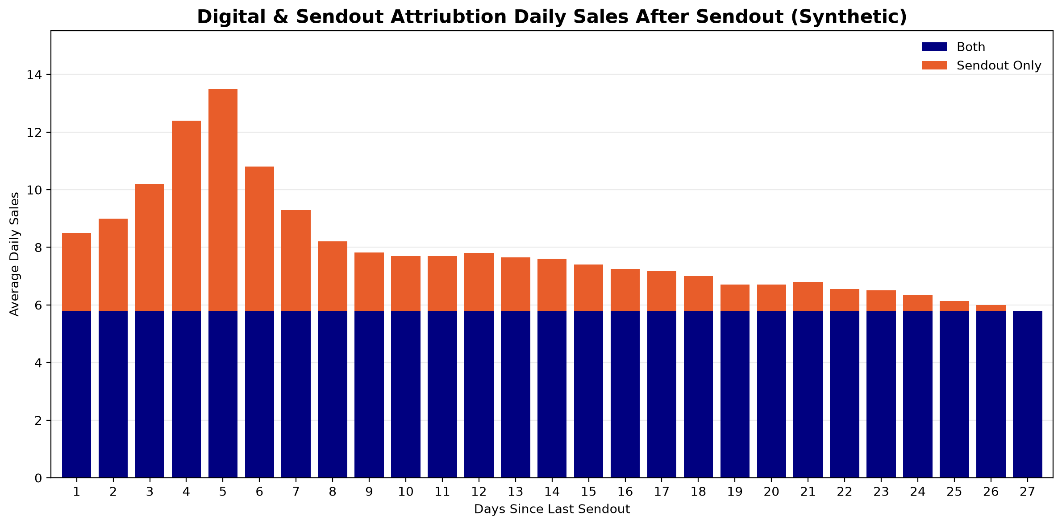
With Model
Attributed as
‘Sendout Only’
Attributed to both
‘Sendout Only’ &
‘Digital Interaction’

Slide 43
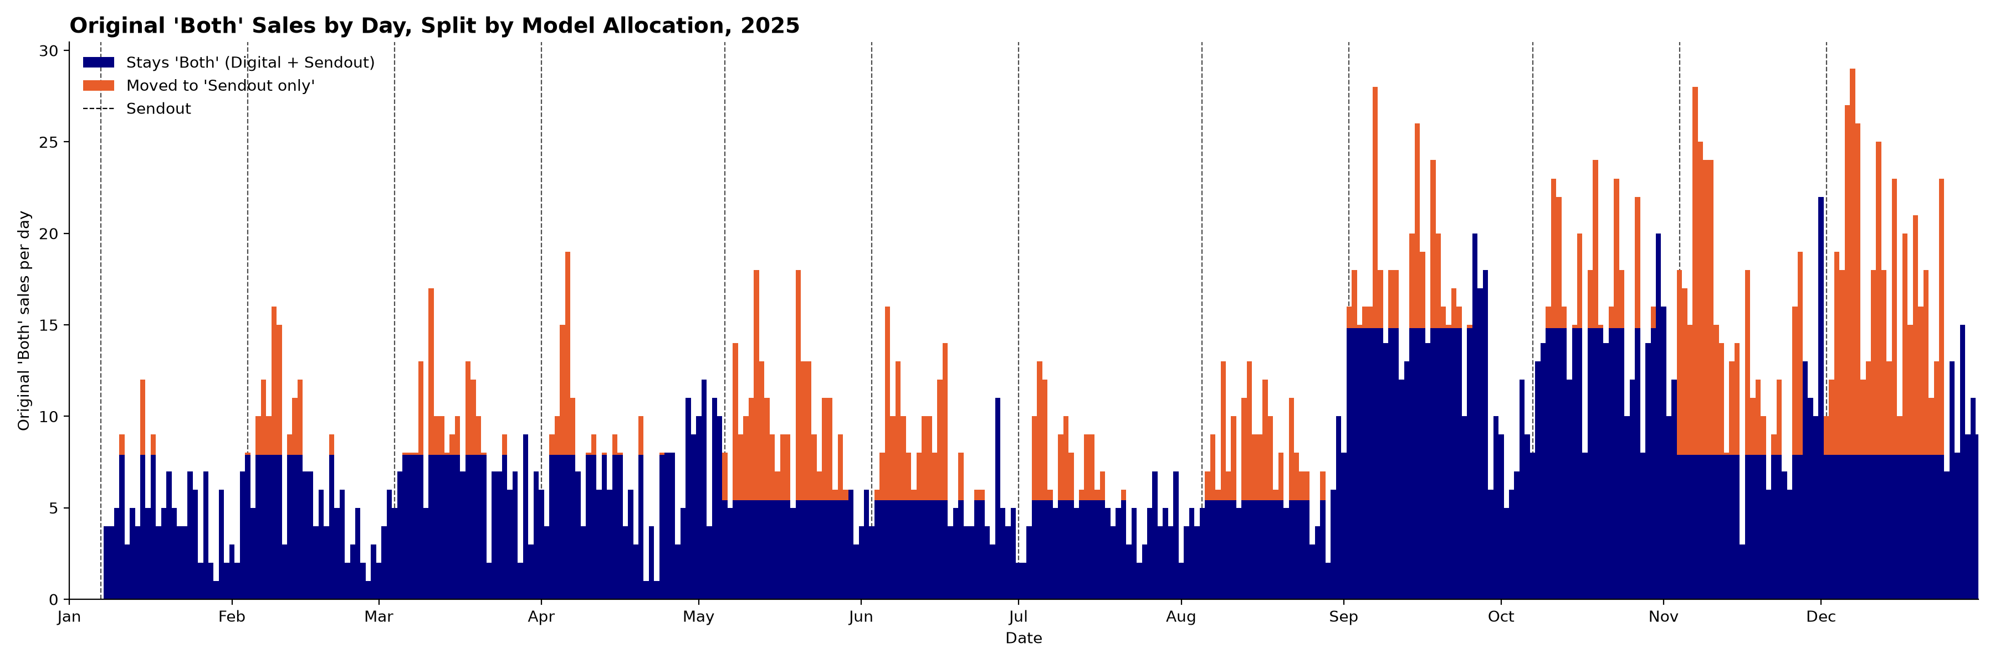
Applied Model
Relocation Threshold (sales per day)
September-October:
May-August:
Other:
>14
>5
>7

Slide 44
Model Reflection
Achievements:
More smartly attribute sales with multiple direct attributions
Addresses Seasonal patterns confounded with advertising swells
No bias as to the shape of the sendout curve
Remaining Limitations:
Time Dimension
  Give more credit to DI’s over 7 days old
  Give less credit to DI that’s not the last touch
Finer-grained Interactions
  With Digital Interactions
  With TV Spots Impressions
Improve Season Boundaries
12-16 Day Hump

Slide 45
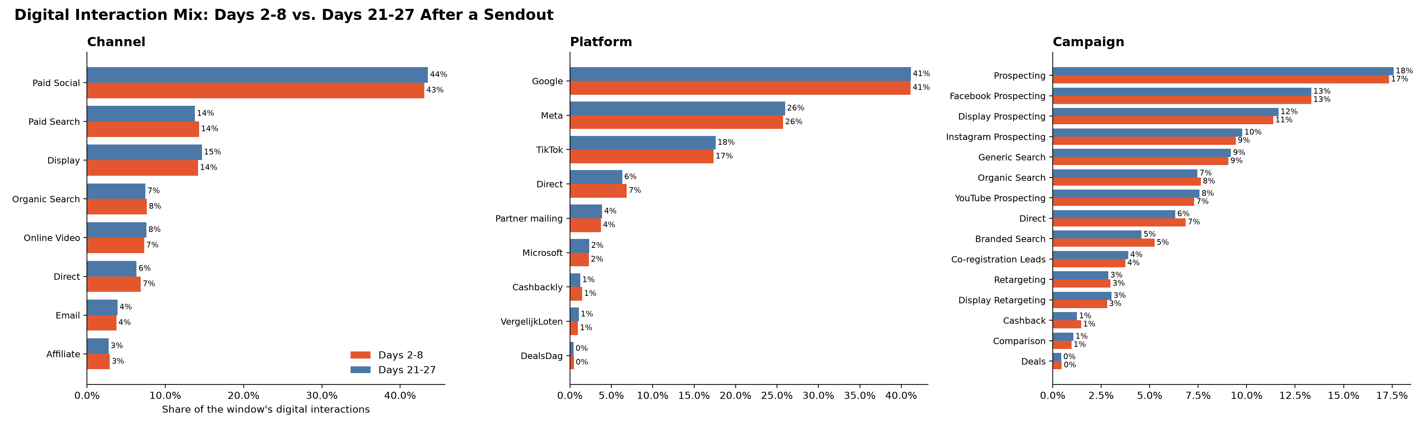
Digital Interaction Mix
- Comparing Days 2-8 after a direct mail sendout to days 21-27
Notes:
Used day of TV Spot and next calender day

Slide 46
Model Results
Channel | Baseline Sales | Δ Model | Final Estimate
Digital | 5553 | -909 | 4644
Sendout | 6557 |  | 6557
TV | 2723 |  | 2723
Overlap reduced from 3558 → 2649

Slide 47
Digital Interaction Mix
Channel | Interactions | % of Total | Scaled Interactions
Paid Social | 4632 | 50 | 3873
Affiliate | 1833 | 20 | 1533
Display | 1342 | 15 | 1122
Online Video | 877 | 10 | 733
Platform | Interactions | % of Total | Scaled Interactions
Meta | 2954 | 32 | 2470
Google | 2219 | 24 | 1856
TikTok | 1678 | 18 | 1403
Cashbackly | 1578 | 17 | 1320
Partner mailing | 506 | 6 | 423
VergelijkLoten | 213 | 2 | 178
Notes:
Used day of TV Spot and next calender day

Slide 48
Digital Interaction Mix
Campaign | Interactions | % of Total | Scaled Interactions
Prospecting | 1678 | 18 | 1403
Cashback | 1578 | 17 | 1320
Facebook Prospecting | 1472 | 16 | 1231
Instagram Prospecting | 1234 | 13 | 1032
Display Prospecting | 1111 | 12 | 929
YouTube Prospecting | 877 | 10 | 733
Co-registration Leads | 506 | 6 | 423
Retargeting | 248 | 3 | 207
Display Retargeting | 231 | 3 | 193
Comparison | 213 | 2 | 178
Deals | 42 | 0 | 35
Notes:
Used day of TV Spot and next calender day

Slide 49
Overlapping Attributions
Overlapping Attributions
Direct attributions with multiple links
Evidence of interactions/multi-channel gains
  TV Spot activity grew sales across all attribution cases
  Holdout group also saw increase from TV Spot activity
Channel | Sales
Digital Interaction | 5553
DM Sendout | 6557
TV Spot | 2723
Attributed Sales | 9934
Actual Sales | 9919
1916 (-15% to TV) sales not attributed directly

Slide 50
Dividing Overlapping Attributions
Let the Data Speak
Isolate effects by finding changes in distributions
  Hard part is finding/removing confounding variables
Methods
  Visualizing, statistical tests
  ML – Regression or Random Forest

Slide 51
Deep Dive Model – DM Sendout
Attribution of sendouts older than 27 days
  Old DM Sendouts getting a lot of credit
Interactions
  With Specific TV
  With Specific DI’s
Variants A/B and their Interactions

Slide 52
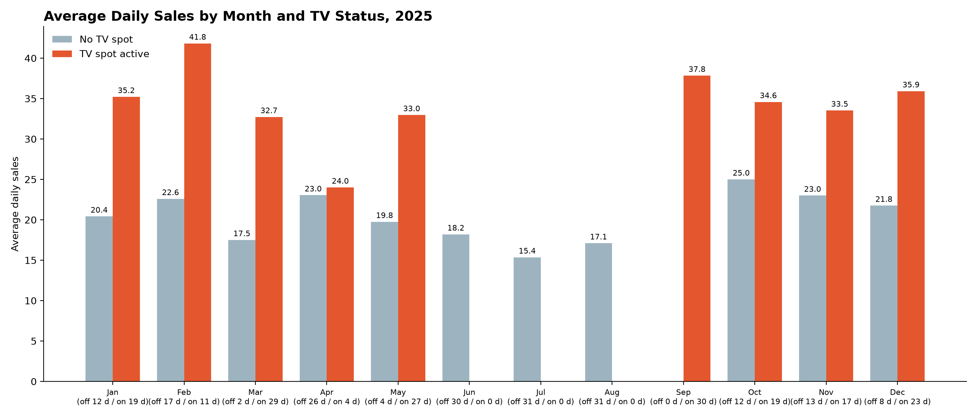
Deep Dive Model – TV Spot
Seasonal/Month effects
Interactions
Effect of different programs
Effect of Impressions
Time of day

Slide 53
Dividing Overlapping Attributions
Let the Data Speak
Isolate effects by finding changes in distributions
  Hard part is finding/removing confounding variables
Methods
  Visualizing, statistical tests
  ML – Regression or Random Forest
More Data
Internal/Public
  Financial
  Neighborhood stats
  Customer history
Acquire more data
  Holdout, A/B Tests
  Surveys
  Demographic
  Tie cookie to address
Informed Judgement
Learn from in-house strategy
Look at research or books
Look at competitors

Slide 54
Recommendation to Marketer
Because the TV boost appears in every month
Try TV Spots in summer
Notes:
Used day of TV Spot and next calender day

Slide 55
Thank You

